Slide 1
6. ReSTful Web Services
Dr. Abdul Razzaq
Abdul.Razzaq@ncirl.ie

Slide 2
Overview
JAXB annotations: @POST annotation
To send/ to post info to a resource
E.g, create and add a new Planet to the collection of planets by providing Planet related info in the body of the HTTP request message, using POST HTTP verb
Exemplification: Extend PlanetsApp RESTful web application
To accept POST HTTTP request
To create and add a new MyPlanet object to the planets collection
Extend MyBlog RESTful web application
To accept POST HTTTP request, where info is in JSON or XML format
To add a new message to our collection as result of a POST HTTP Request sent by a client
To filter the list of messages requested based on some criteria

Slide 3
6.11 JAXB : @POST annotation

Slide 4
POST HTTP verb
RESTful Web services must support the CRUD functionality operations set
CRUD = Create, Read, Update, and Delete
HTTP verbs are mapped into these 4 operations
Create = PUT or POST
Read = GET
Update = PUT
Delete = DELETE
POST verb is used to create new resources. In particular, it's used to create subordinate resources. E.g. an instance resource (that’s a subordinate resource) of a collective resource (parent resource
E.g. a new Planet resource within the Planets dataset/collective resource
when creating a new resource, we POST to the parent/collective resource that takes care of associating the new resource with the parent, and assigning an ID (new resource URI)

Slide 5
POST HTTP verb
Examples of using POST
POST http://localhost:49000/api/customers - the body of HTTP request message will have detaild of the new customer to be created
POST http://localhost:49000/api/customers/12345/orders
POST http://localhost:49000/api/planets - add a new planet to our collective resource planets ( e..g Arraylst of MyPlanet objects)
POST is neither safe nor idempotent
Sending two identical POST requests will result in two different resources containing the same information. Resources will have different ID and URI assigned

Slide 6
PlanetsApp: Accepting POST requests
PlanetsApp (with POST) – Application code extended to provide functionality when POST HTTP request is received with /planets resource URI
Objective: Add a new MyPlanet type object to the planets collection
PlanetsApp – consists of 2 java files
MyPlanet.java class – no modification required
PlanetsService.java – updates performed
implement functionality @POST for /planets resource when planet’s details provided in XML format
implement functionality @POST for /planets resource when planet’s details provided in JSON format
Once the new planet resource was created, the newly created MyPlanet object is added to the ArrayList and then returned to the client app in XML or JSON format

Slide 7
PlanetsApp: Accepting POST requests
PlanetsApp – consists of 2 java files
MyPlanet.java class – no modification required
PlanetsService.java – updates performed
Define ArrayList list member as static to keep the content between multiple calls of the resource
public static ArrayList<MyPlanet> list =new ArrayList<>();
A static field has the same value in all the instances of the class. It is created and initialised when the class is loaded for the first time
Populate once only the collection with items in the class constructor, and not for each instance of the class
public static boolean init = true;
...
if(init){
MyPlanet p1 = new MyPlanet(1,"Earth");
list.add(p1);
MyPlanet p2 = new MyPlanet(2, "Mercury");
list.add(p2);
init = false;
}

Slide 8
PlanetsApp: Accepting POST requests
Functionality for @POST /planets resource when planet’s details are provided in XML format. Newly created planet is returned in XML format
@POST
@Consumes(MediaType.APPLICATION_XML)
@Produces(MediaType.APPLICATION_XML)
public MyPlanet postNewPlanetXML(MyPlanet p)
{
p.setId(list.size() + 1);
list.add(p);
System.out.println("new MyPlanet resource created with path:
/planets/" + String.valueOf(p.getId()));
System.out.println("new planet details:"+p.printPlanet());
return p;
}

Slide 9
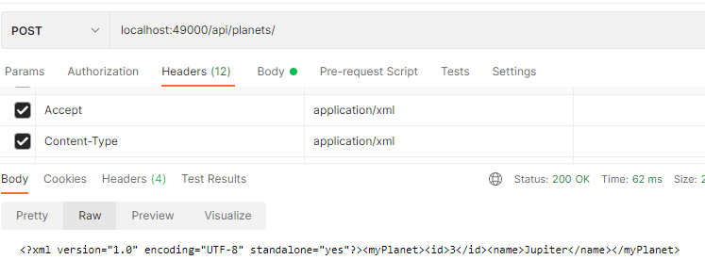
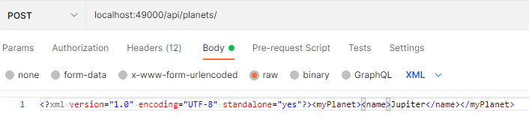
PlanetsApp: Accepting POST requests
Functionality for @POST /planets resource when planet’s details are provided in XML format. Newly created planet is returned in XML format
Testing in POSTMAN
Headers Settings -> Accept format and Content-Type format
Body Setting -> XML format of Planet info (e.g. name of the new planet)

Slide 10
PlanetsApp: Accepting POST requests
Functionality for @POST /planets resource when planet’s details are provided in JSON format. Newly created planet is returned in JSON format
@POST
@Consumes(MediaType.APPLICATION_JSON)
@Produces(MediaType.APPLICATION_JSON)
public MyPlanet postNewPlanetJSON(MyPlanet p)
{
p.setId(list.size() + 1);
list.add(p);
System.out.println("new MyPlanet resource created with path:
/planets/" + String.valueOf(p.getId()));
System.out.println("new planet details:"+p.printPlanet());
return p;
}

Slide 11
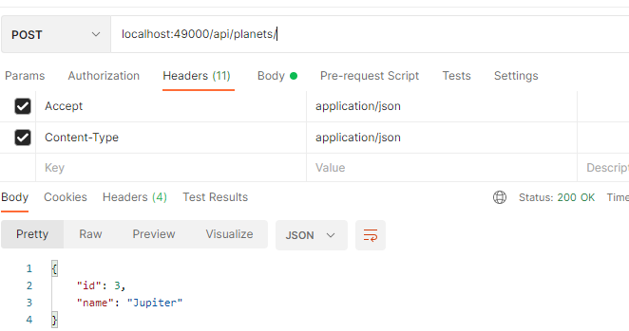
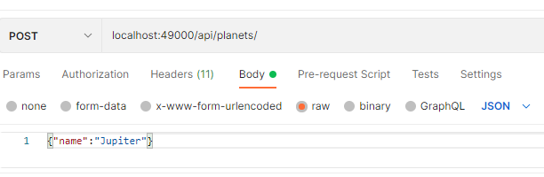
PlanetsApp: Accepting POST requests
Functionality for @POST /planets resource when planet’s details are provided in JSON format. Newly created planet is returned in JSON format
Testing in POSTMAN
Headers Settings -> Accept format and Content-Type format
Body Setting -> JSON format of Planet info (e.g. name of the new planet)

Slide 12
PlanetsApp: Accepting POST requests
TASK
Download PlanetsApp (with POST) from Moodle page
Run the application in NetBeans 12
Test the POST /Planets resource call to add a new planet
Set POST HTTP verb
Set the Headers field to specify
Content-Type of the message provided in the body ( e.g. planet info)
Accept format of the HTTP response message body
Set the Body part of the HTTP request message
SET the resource URL to be called: localhost:49000/api/planets/
To check if the new planet was added to the collection call /planets resource with the GET verb
GET localhost:49000/api/planets/

Slide 13
6.12 BLOG App - POST a new message

Slide 14
BLOG App with POST new message
We will extend the MyBlog application in order to be able to
Add a new message to our collection as result of a POST HTTP Request sent by the client
Filter the list of messages requested based on some criteria
Classes MessageService.java class and MessageResource.java will be extended to add the above functionalities.
Step-By-Step description provided in MyBlog –Post and Filtering Document
Follow the description to implement these two new features in the Blog app

